Slide 1
Digital Portfolio
STUDENT NAME: Yuvaraj.c
REGISTER NO AND NMID: asunm163u24cs121
DEPARTMENT: Bsc.computer science
COLLEGE: COLLEGE/ UNIVERSITY
Hindustan College of arts & science/Madras University

Slide 2
PROJECT TITLE
Digital student portfolio using html

Slide 3


AGENDA
Problem Statement
Project Overview
End Users
Tools and Technologies
Portfolio design and Layout
Features and Functionality
Results and Screenshots
Conclusion
Github Link
3/21/2024 Annual Review

Slide 4

PROBLEM STATEMENT
Lack of a centralized and professional portfolio system.
Difficulty in showcasing skills, projects, and achievements effectively.
Limited visibility for students/professionals in the job market.
Need for a user-friendly digital solution.

Slide 5

PROJECT OVERVIEW
A portfolio website for presenting skills and projects.
Focus on clean design and responsive layout.
Easy navigation for end users (recruiters/clients).
Includes interactive features like contact forms and project links.

Slide 6
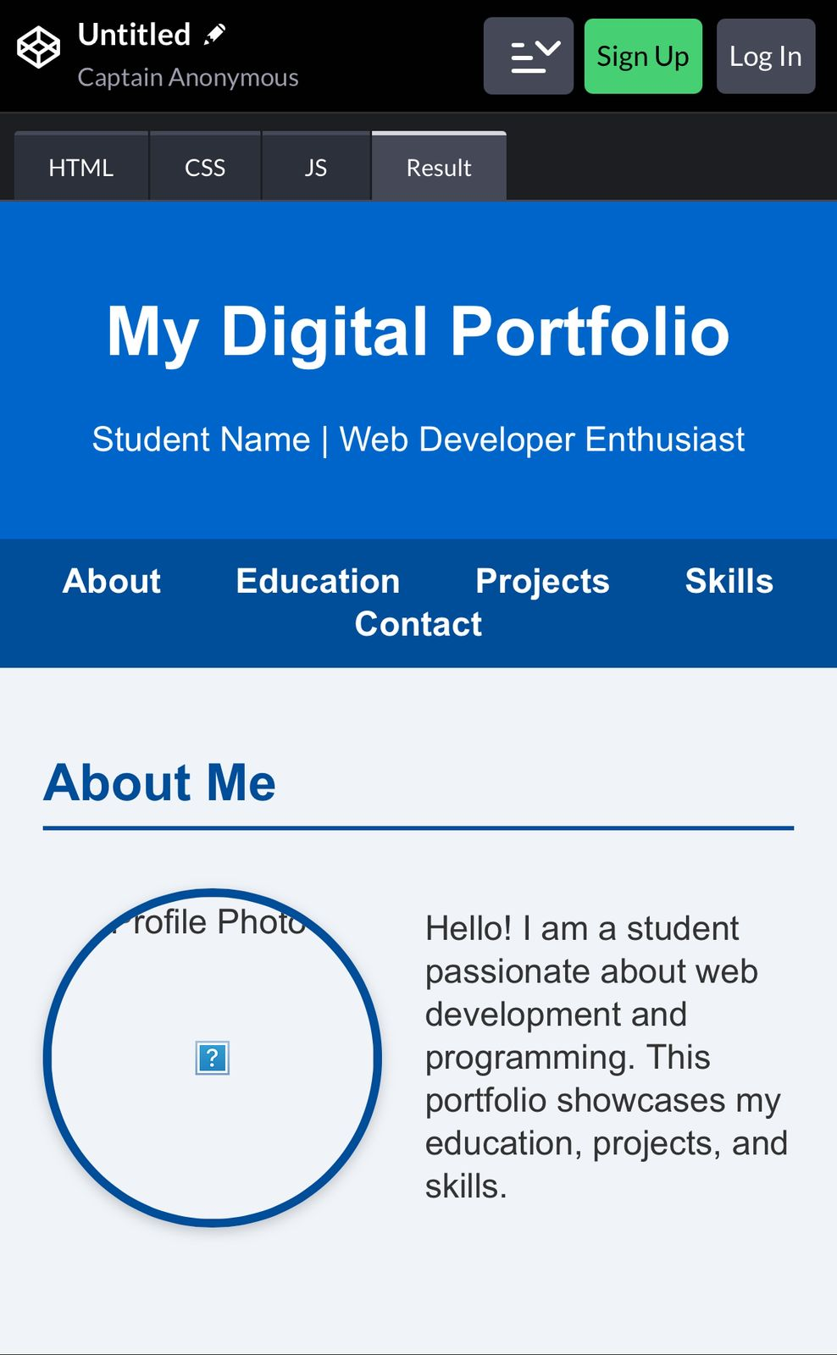
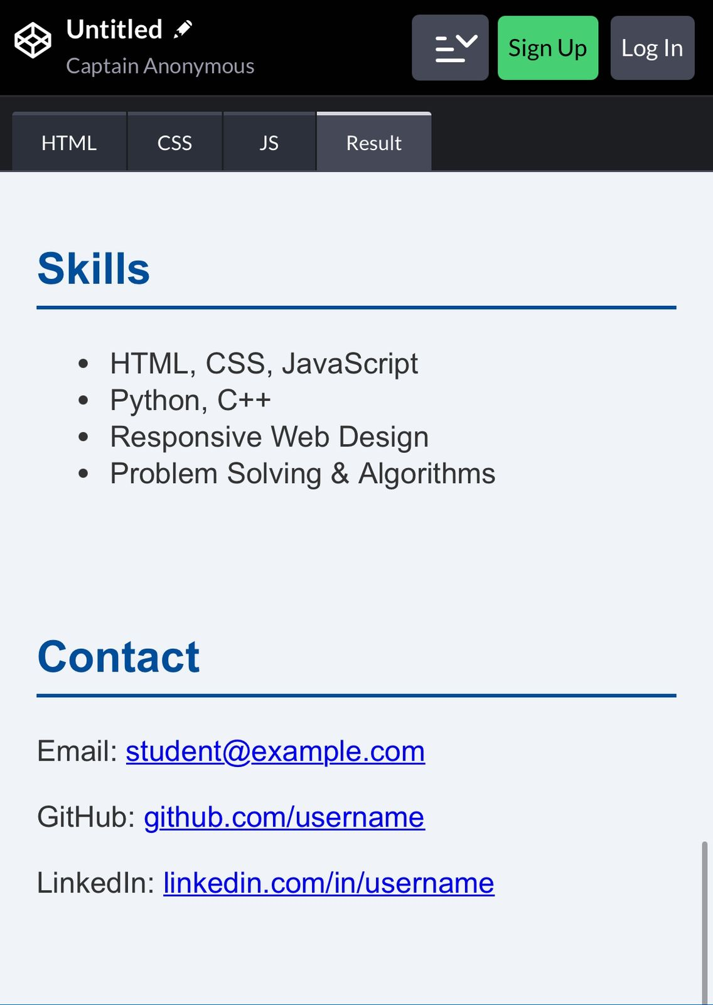
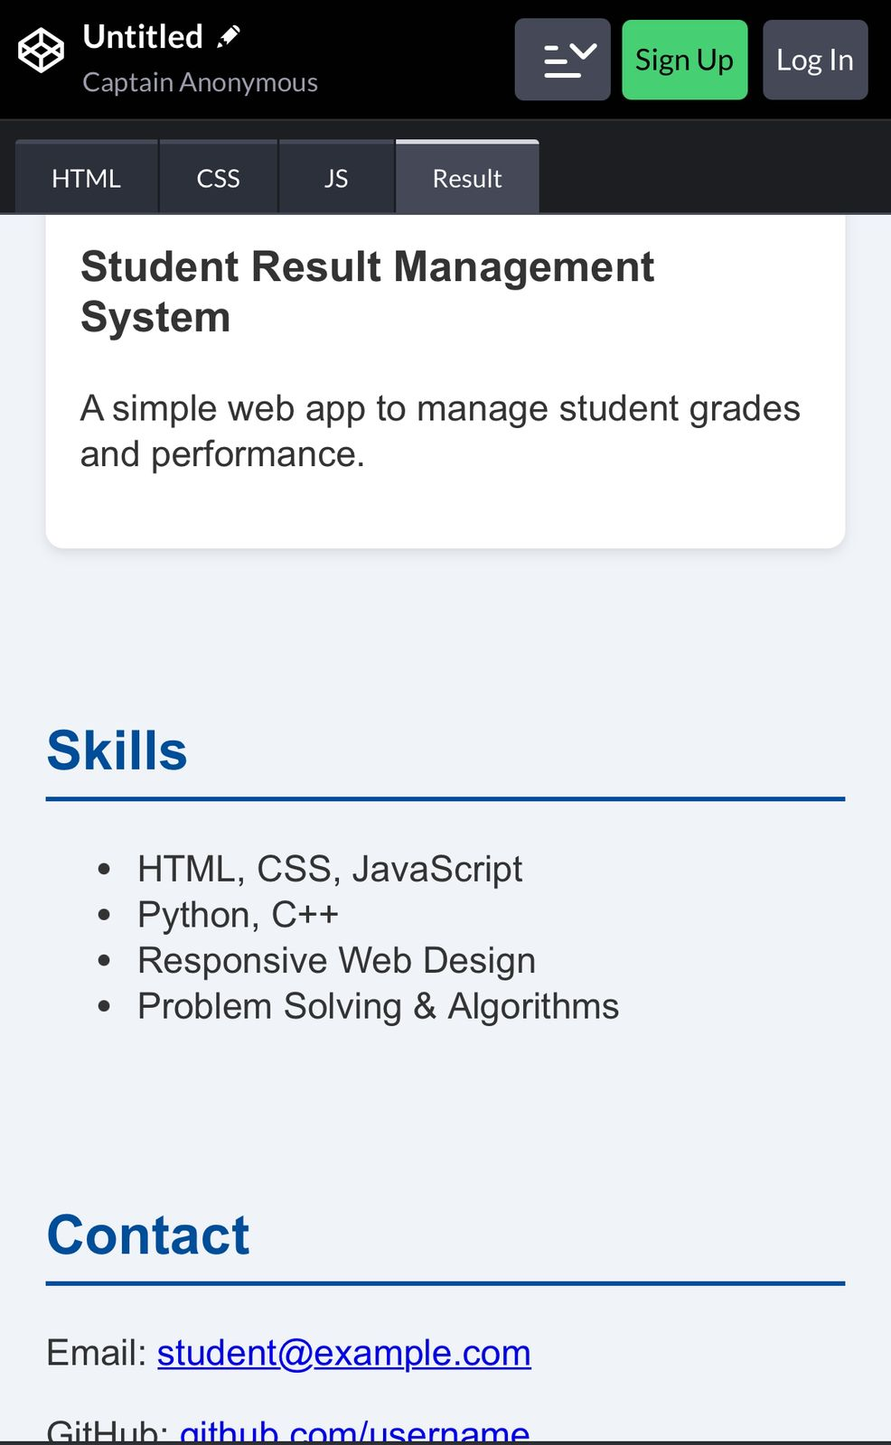
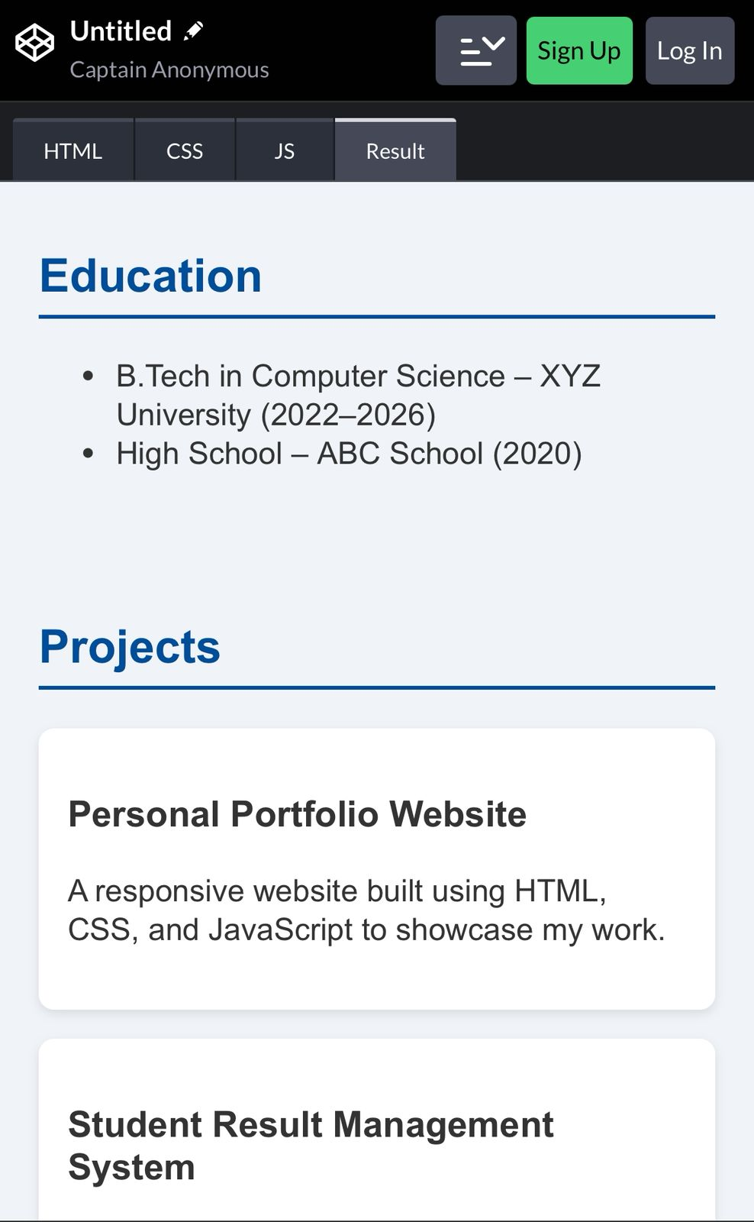
Screen shot

Slide 7

WHO ARE THE END USERS?
Students and job seekers.
Freelancers showcasing work to clients.
Recruiters and hiring managers.
Professionals building personal branding.

Slide 8

TOOLS AND TECHNIQUES
Frontend: HTML, CSS, JavaScript, React.
Backend: Node.js / Express (optional).
Database: MongoDB / MySQL.
Version Control: Git & GitHub.

Slide 9
POTFOLIO DESIGN AND LAYOUT
Minimal and professional design.
Responsive (works on desktop & mobile).
Clear sections: About, Skills, Projects, Contact.
Consistent color scheme and typography.
9

Slide 10
FEATURES AND FUNCTIONALITY
Interactive project showcase with images/links.
Downloadable resume option.
Contact form for inquiries.
Smooth navigation and animations.

Slide 11

RESULTS AND SCREENSHOTS
Successfully deployed live portfolio site.
Positive feedback from users/recruiters.
Enhanced personal branding and visibility.
Screenshots of homepage, skills, and project sections.
3/21/2024 Annual Review
11

Slide 12
CONCLUSION
Portfolio helps in professional growth and opportunities.
Easy to update and maintain.
Bridges the gap between skills and visibility.
Future improvements: blog integration, dark mode.
12

